Slide 1
Technical Communication
Part 4 Learning Important Application
Job-Application Materials

Slide 2
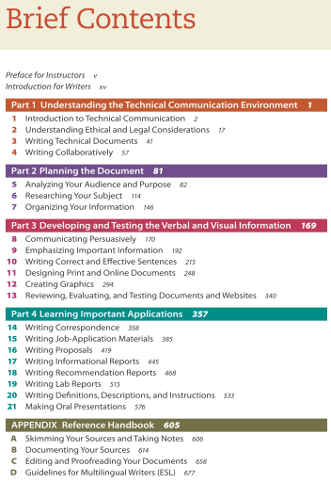


Slide 3
3 questions to go
Do you have a résumé? In Chinese or English version?
Do you think what are the important elements in a résumé?
What is the difference between résumé and CV?

Slide 4
Contents
RÉSUMÉ Writing Process
Planning
Identifying the Career Center’s website
Drafting
Revising
Editing
Proofreading
Write your Chinese and English RÉSUMÉ
Job Application Letter
Job Interview
Prepare for Job Interview
After Job Interview
Model Job Interview

Slide 5
Do you want to get a job?
GETTING HIRED has always involved writing!

Slide 6
What are the important factors to secure a job?

Slide 7
Résumé Writing Process
Planning
Drafting
Revising
Editing
Proofreading

Slide 8
1.1 Establishing you personal brand

Slide 9
1.1 Establishing you personal brand
Create a strong online presence
Participate on LinkedIn
Participate on social media
Create a business card
Practice an “Elevator Pitch”

Slide 10
1.1.1 Create a strong online presence
The best online presence is your own web-site, which functions as your online headquarters. All your other online activities will link back to this one site, the only site on the Internet that is all about you. Register a site and try to name it yourname.com (you will be required to pay a small fee to secure the domain name). If you aren’t experienced designing and creating sites, try a drag-and-drop site builder like Weebly or Squarespace, or use a template from a free blogging site such as WordPress.
Upload to your site everything you want potential employers to see: contact information, a professional history, work samples, documents, and links to your accounts on social-media sites. If you don’t have a website, take advantage of all the features on LinkedIn.

Slide 11
1.1.2 Participate on LinkedIn
LinkedIn is the major social-media site used by employers to find employees.
Set up a LinkedIn account and create a profile that includes the keywords that will attract potential employers.
Rather than calling yourself a “programmer at ADP,” which describes your current situation, call yourself “an experienced programmer in various programming languages (Java, C, C ++ , and PHP) and scripting languages (JavaScript, Perl, WSH, and UNIX shells) who understands interactive web pages and web-based applications, including JavaServer Pages (JSP), Java servlets, Active Server Pages (ASP), and ActiveX controls.”
Including keywords makes it easier for potential employers to find you when they search for employees.
list specific skills in the “Skills and Abilities” section of your profile.
Potential employers searching for specific skills can then locate you more easily, and colleagues who know your work can endorse you for various skills.
Participate actively on LinkedIn;
when you read a good article or see a useful video, link to it so others can find it. Participate in forum discussions. Make connections and endorse people who you know have good qualifications.

Slide 12
1.1.5 Practice an “elevator pitch.”
An elevator pitch is a brief oral summary of your credentials.
At less than 20 seconds long, it’s brief enough that you can say it if you find yourself in an elevator with a potential employer. After the pitch, you hand the person your business card, which contains all the information he or she needs to get to your website, which links to everything else you want that person to see about you.

Slide 13
1.2 Planning job search
1. Do a Self-inventory
— What are your strengths and weaknesses? Are your skills primarily
technical? Do you work best with others or on your own?
— What subjects do you like? Think about what you have liked or disliked about your jobs and college courses.
— What kind of organization would you like to work for? For profit or
nonprofit? Government or private industry? Small or large? Startup or established?
— What are your geographical preferences? If you are free to relocate, where
would you like to live? How do you feel about commuting?

Slide 14
1.2. Planning job search
2. Learn about potential employers.
— start learning about the company by studying its website. But don’t stop there. Conduct informational interviews with people who have worked there or who know people who have; ask your professors if they can help you identify people to interview.
— Attend job fairs.
—Find out about trends in your field.

Slide 15
1.2 Planning job search
Prepare a résumé and (perhaps) a job-application letter (a cover letter).

Slide 16
1.2 Planning job search
Put your portfolio items online.
You should put your portfolio on your website and other online locations, such as your LinkedIn account.

Slide 17
1.2 4 Major Ways to Look for a Position
Through an organization’s website
Through a job board on the Internet
Through your network
Through a college or university placement office or professional placement

Slide 18
LinkedIn

Slide 19
Using LinkedIn’s Employment Features
Use the profile section fully
Include a picture
Post updates
Write unique invitation requests
Write unique invitations to connect

Slide 20
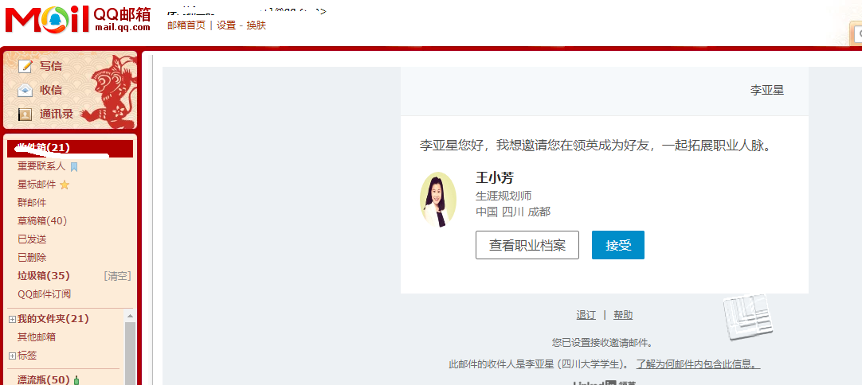
http://www.linkedin.com/feed/

Slide 21
Exercise 1 Identifying the Career Center’s website
Each group research an online Career Center about:
How is the website structured?
Using an example to locate the information you need.
How to register and upload your personal information?
And other feature.

Slide 22
Résumé Writing Process
Planning
Drafting
Revising
Editing
Proofreading

Slide 23
Writing Résumé

Slide 24
Keywords
The best way to be sure you have the appropriate keywords in your résumé is to study the job description in the actual job posting you want to respond to.
Then find ten other ads for similar positions and identify the terms that come up frequently.

Slide 25
Types of résumé
Chronological résumé
Skills résumé
Reverse Chronology
Timeline
The duties and accomplishments related to each job.
Reverse Chronology
Skills section
A popular choice for applicants who have a gap in their employment history.

Slide 26
Elements of the Chronological résumé
Identifying Information
Summary Satement
Education
Employment History
Interests and Activities
References
Other Elements

Slide 27
Identifying Information
Full name
Address including the zip code
Phone number
Email address

Slide 28

Summary Statement
Highlight three or four important skills or accomplishments.

Slide 29
Education
Your degree
- BS in English Translation, minor in Investment
The institution
The location of the institution
The date of graduation
Information about other schools you attended

Slide 30
Elaborating on Your Education
List your grade-point average
Compile a list of courses
No listing required
Describe a special accomplishment
Special Senior Design or Research Project
Internship
List honors and awards you received

Slide 31
Employment History
The dates of employment
The organization’s name and location
Your position or title
A TWO-TO-THREE-LINE description for each position
Skills
- what technical skills did you use on the job?
Equipment
- What equipment did you operate or oversee?
Money
How much money were you responsible for?
Documents
- What important documents did you write or assist in writing?
Personnel
- How many people did you supervise?
Clients
- What kinds of clients and how many, did you do business with?

Slide 32
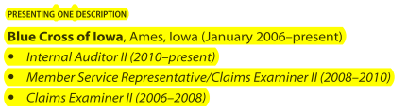
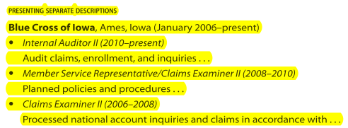
If you have had several positions with the same employer,

Slide 33
Interests and Activities
Participation in community-service organizations
Hobbies related to your career
Sports
University-sanctioned activities
- Membership on a team; work on the college newspaper…

Slide 34
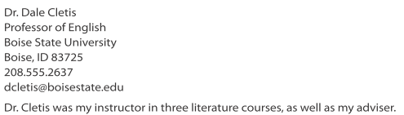
References
These people who are willing to speak or write on your behalf are called references.

Slide 35
Other Elements
Computer skills
Language ability
Willingness to relocate

Slide 36
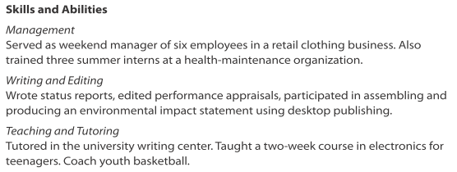
Elements of the skills résumé
Skills/ Skills and Abilities

Slide 37
Résumé Writing Process
Planning
Drafting
Revising
Editing
Proofreading

Slide 38
Language And Style In Résumé

Slide 39
Formatting a Plain-Text Résumé
It has no special characters
It has a line length of 65 or fewer characters
It uses a non-proportional typeface such as Courier
Most of the information is left justified
It uses ALL UPPERCASE or repeated characters for emphasis

Slide 40
Note:
Use the active voice. The active voice highlights action.
- (“supervised three workers”) rather than the passive voice (“three workers were supervised by me”).
Omit the I at the start of sentences:
-“Prepared bids,” rather than “I prepared bids.”

Slide 41
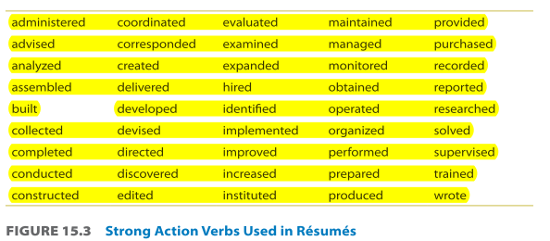

Slide 42
Errors to aviod
1. Provocative or unprofessional photos or text (49 percent of employers who mentioned problems mentioned this one)
2. Photos or text showing drug or alcohol use (45 percent)
3. Poor writing (35 percent)
4. Negative comments about current or former employers (33 percent)
5. Discriminatory comments about race, gender, or religion (28 percent)
6. Lies about the candidate’s credentials (22 percent)

Slide 43
Exercise 2

Slide 44
Exercise 3
According to the lecture, prepare your own Chinese and English Résumé.

Slide 45
Job Application Letter

Slide 46
Writing Job-Application Letters(CV)
Applicants can explain more clearly in a letter than in a résumé how their qualifications match the employer’s requirements.
They can explain their professional relationship with someone in the employer’s organization or gaps in their employment history.
Perhaps most important, applicants can show that they can write well.

Slide 47
Job Interview

Slide 48
Preparing for job interview
Study job interview.
cover everything from how to do your initial research to common interview questions to how to dress.
Study the organization to which you applied.
Start with the organization’s own website, especially corporate blogs, and then proceed to other online and print resources. Search for the organization’s name on the Internet.
Think why the organization offers the job opening.
Think about what you can offer the organization.
Think about how your academic career, your work experience, and your personal characteristics and experiences have prepared you to solve problems and carry out projects to help the organization succeed.
Study lists of common interview questions.
— Can you tell me about yourself?
— Where do you see yourself in five years?
— Why did you apply to our company?
— What do you see as your greatest strengths and weaknesses?
— Tell me about an incident that taught you something important about yourself.
— What was your best course in college? Why?
Compile a list of questions you wish to ask.
Do not focus on salary, vacation days, or sick leave
Rehearse the interview.

Slide 49
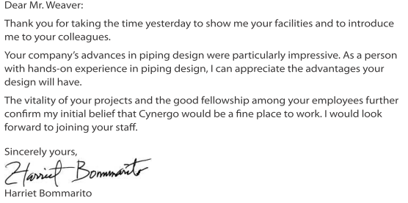
Writing Follow-up Letters or Emails After an Interview
Letter of appreciation after an interview.
You can also restate your interest in the position and mention a specific topic of conversation you found particularly interesting or a fact about the position you found exciting.

Slide 50
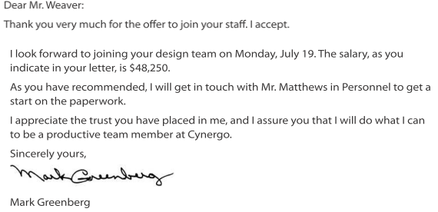
Writing Follow-up Letters or Emails After an Interview
Letter accepting a job offer.

Slide 51
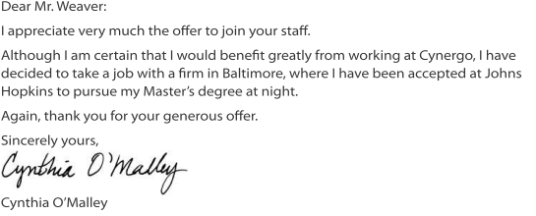
Writing Follow-up Letters or Emails After an Interview
Letter rejecting a job offer.

Slide 52
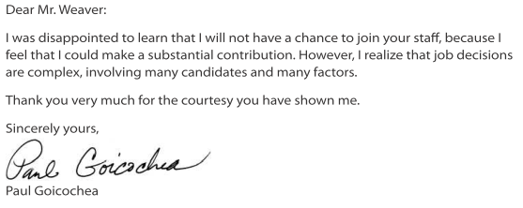
Writing Follow-up Letters or Emails After an Interview
Letter acknowledging a rejection.

Slide 53
Checklist and Exercise

Slide 54
Exercise 4-Model Job Interview
Each group divide into 2 parts: Interviewers and Interviewees
Interviewer team:
Introduce the background of your company and Write a job opening description. And post these positions in advance.
Interview interviewees from other groups.
Interviewee team:
Prepare your Résumé in accordance with the post you want to apply.
Prepare for job interview

